Slide 1

TUT ASSESSMENT · INTEGRATED SOFTWARE PROJECT
ASSIGNMENT 4
PRESENTATION
AI-Enhanced Missing Children Reporting System

Slide 2
PRESENTER
STUDENT NUMBER
N
MATHEBULA
216080254
Tshwane University of Technology
Integrated Software Project · 2026
ISJ107V

Slide 3
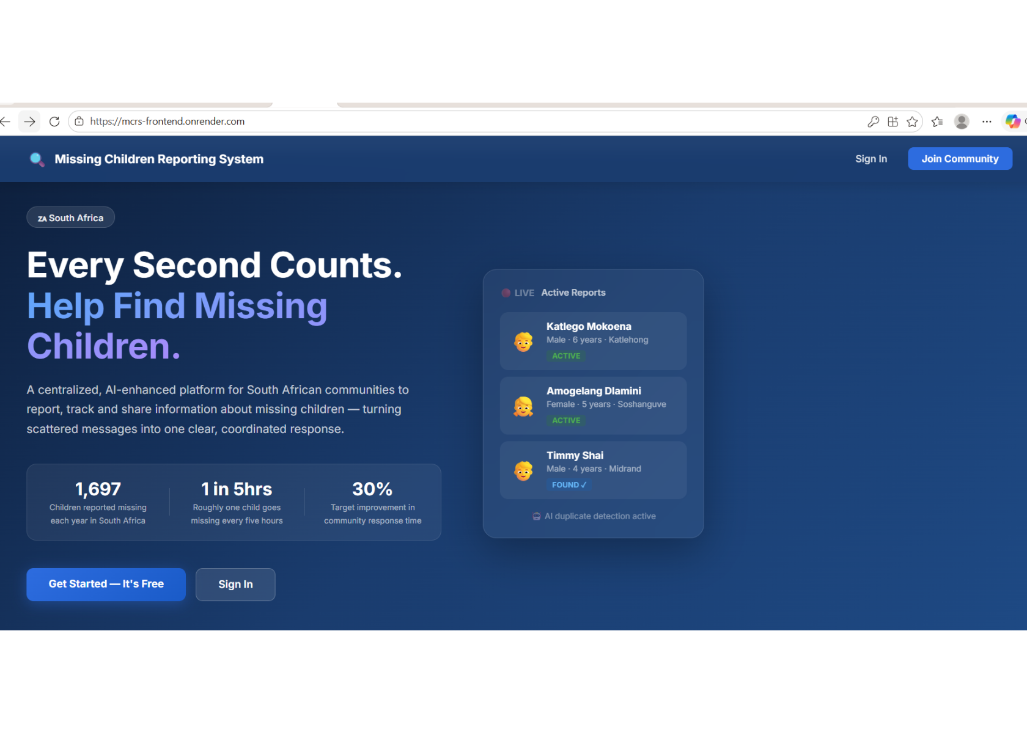
PROJECT OVERVIEW
AI-enhanced
community reporting.
A secure platform for reporting and tracking missing children, with artificial intelligence that automatically detects duplicate reports.

Slide 4
SLIDE 1 · TITLE
AI-ENHANCED COMMUNITY-BASED MISSING CHILDREN REPORTING AND TRACKING SYSTEM
N Mathebula · 216080254 · ISJ107V
Integrated Software Project · 2026 · Tshwane University of Technology
Notes:
“Good day. My name is N Mathebula. My project is an AI-enhanced platform that helps South African communities report and track missing children, with artificial intelligence that automatically detects duplicate reports.”

Slide 5
SLIDE 2 · THE PROBLEM
Information is scattered when every hour matters.
1 697
1 in 5 hrs
CHILDREN REPORTED MISSING EVERY YEAR
ONE CHILD EVERY FIVE HOURS
Fragmented channels
Social media, WhatsApp groups and word of mouth slow the spread of critical information.
The same child may be reported many times in different words, with no central place to see or analyse cases.
Notes:
“The stakes are high and the current process is broken - information is scattered, response is slow, and the same child gets reported several times, wasting responders’ effort.”

Slide 6
SLIDE 3 · THE SOLUTION
One secure platform turns reports into a shared response.
01
02
03
04
05
Report
Alert
Find
Review
Close
Photo and full description.
Every registered member instantly.
Search, filter and share active cases.
AI detects possible duplicates.
Mark a child as found safely.
Notes:
“My solution replaces those fragmented channels with one platform. Everyone reports to the same place, everyone is alerted, and the system keeps the data clean using AI.”

Slide 7
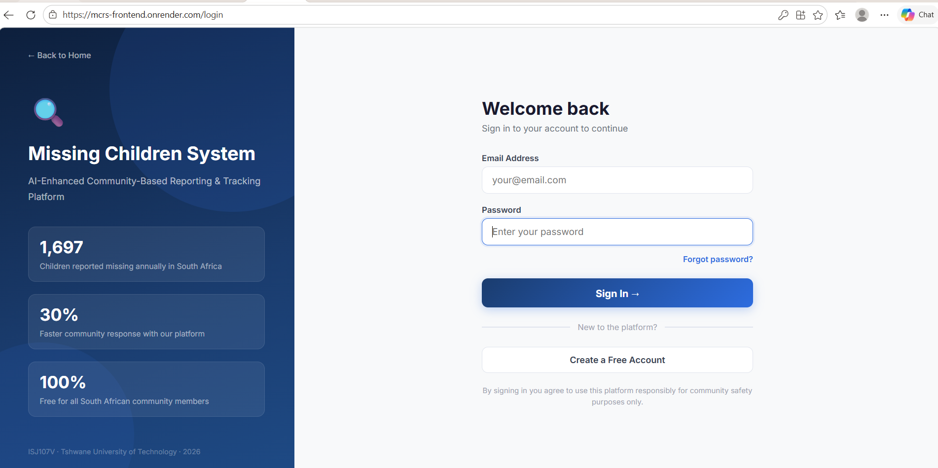
Register/Login Page
Notes:
“My solution replaces those fragmented channels with one platform. Everyone reports to the same place, everyone is alerted, and the system keeps the data clean using AI.”

Slide 8
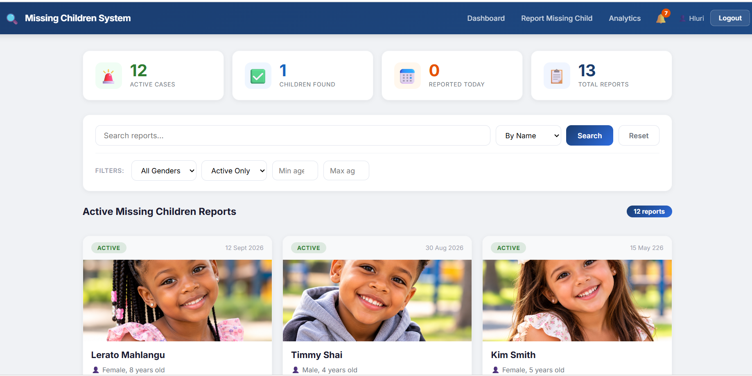
Dashboard
Notes:
“My solution replaces those fragmented channels with one platform. Everyone reports to the same place, everyone is alerted, and the system keeps the data clean using AI.”

Slide 9
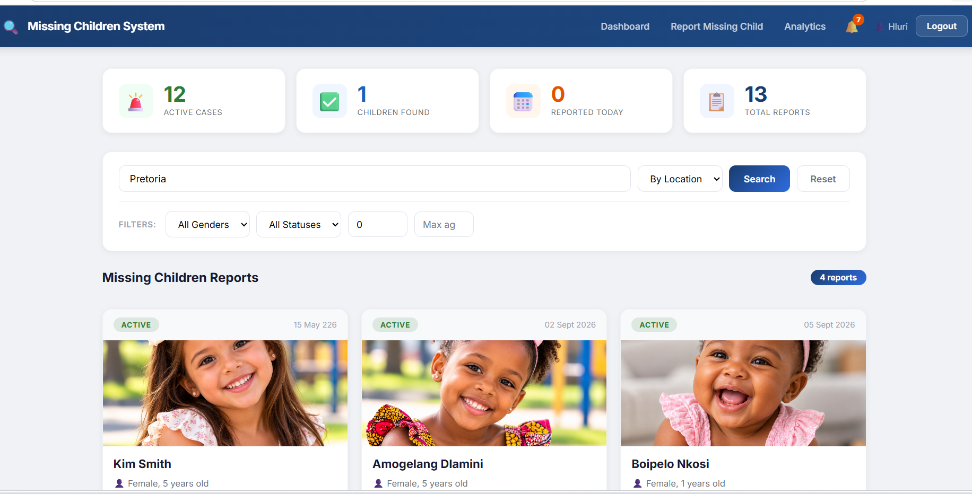
Dashboard – Filter search
Notes:
“My solution replaces those fragmented channels with one platform. Everyone reports to the same place, everyone is alerted, and the system keeps the data clean using AI.”

Slide 10
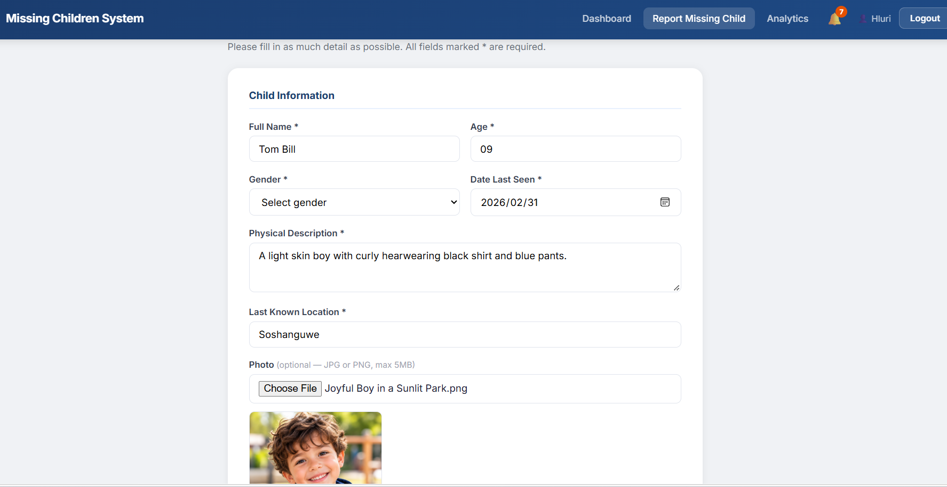
Report Missing Child
Notes:
“My solution replaces those fragmented channels with one platform. Everyone reports to the same place, everyone is alerted, and the system keeps the data clean using AI.”

Slide 11
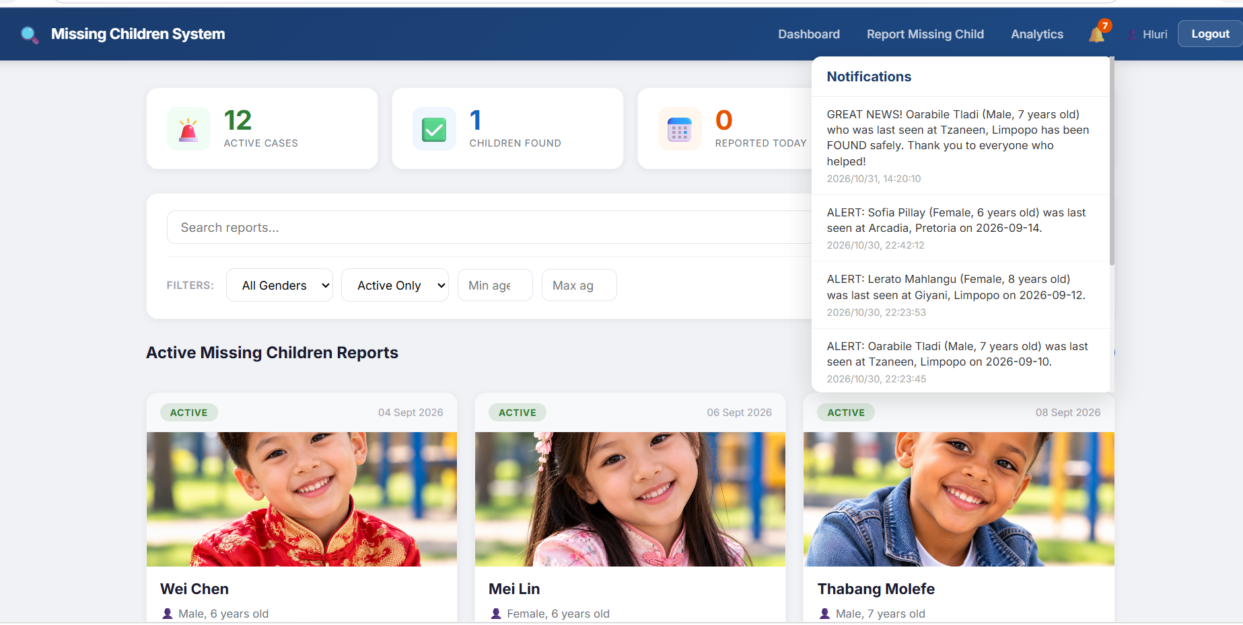
Notifications
Notes:
“My solution replaces those fragmented channels with one platform. Everyone reports to the same place, everyone is alerted, and the system keeps the data clean using AI.”

Slide 12
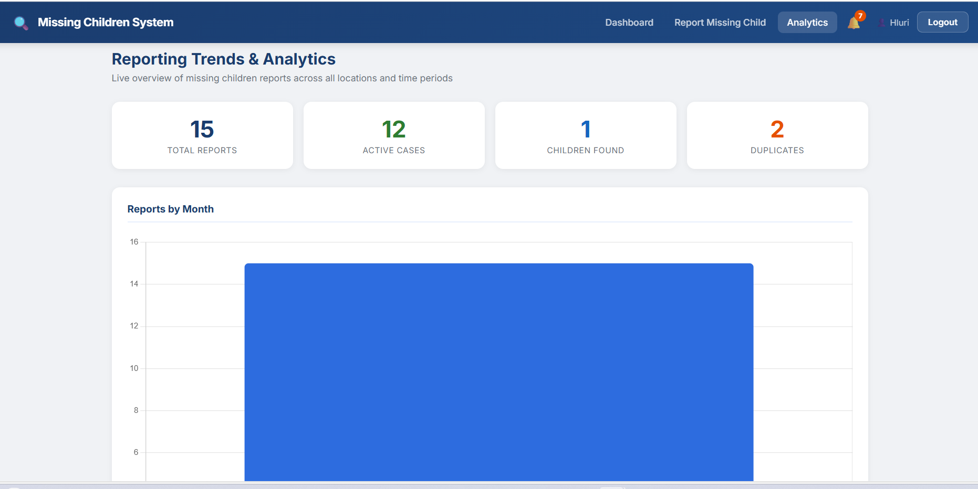
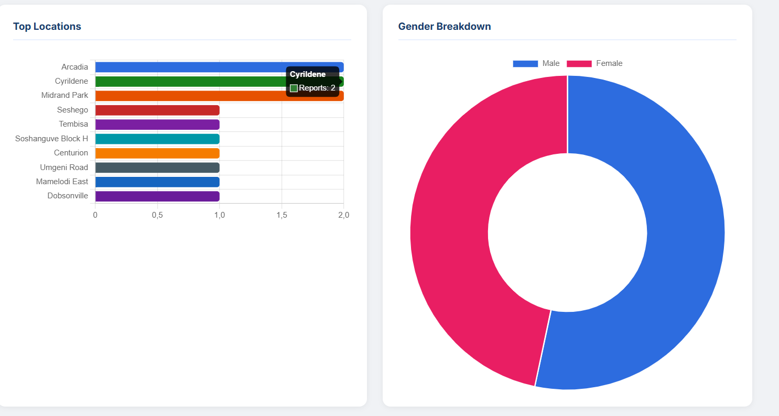
Analytics
Notes:
“My solution replaces those fragmented channels with one platform. Everyone reports to the same place, everyone is alerted, and the system keeps the data clean using AI.”

Slide 13
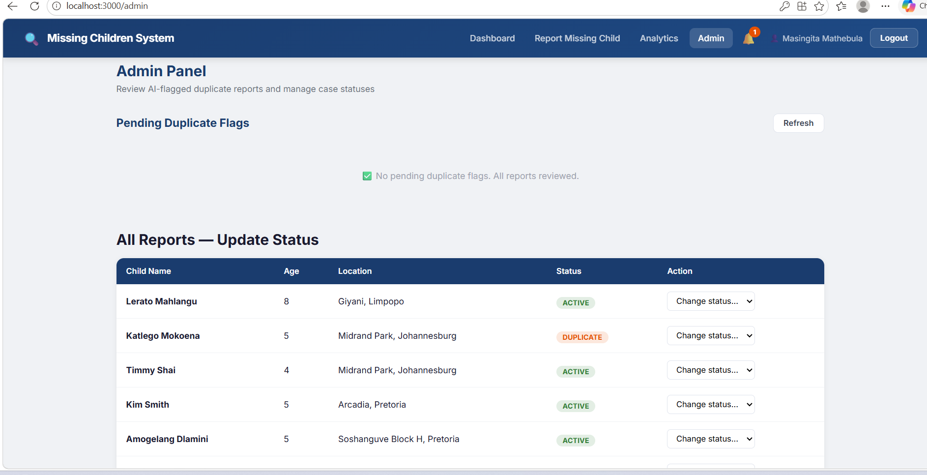
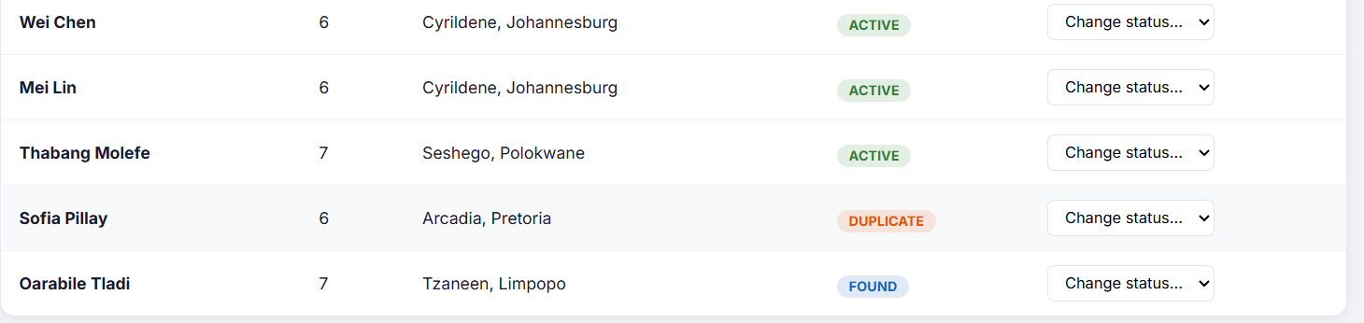
Admin panel
Notes:
“My solution replaces those fragmented channels with one platform. Everyone reports to the same place, everyone is alerted, and the system keeps the data clean using AI.”

Slide 14
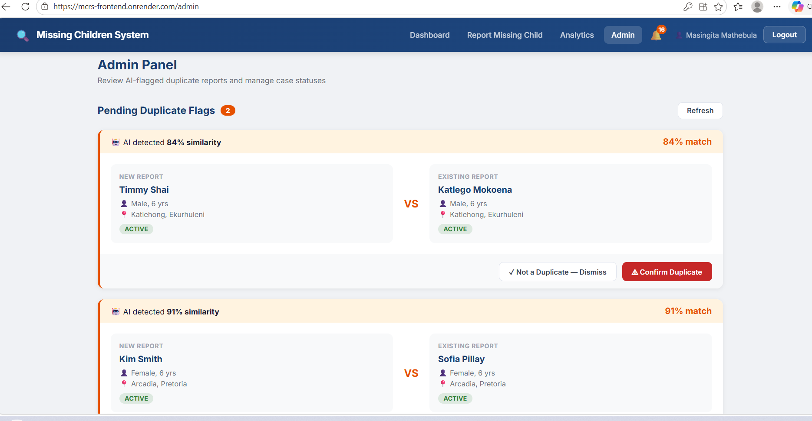
AI Duplicate Detection
Notes:
“My solution replaces those fragmented channels with one platform. Everyone reports to the same place, everyone is alerted, and the system keeps the data clean using AI.”

Slide 15
SLIDE 4 · SYSTEM ARCHITECTURE
Four services, connected by secure HTTPS and REST.
React frontend
Java Spring Boot backend
Python AI service
PostgreSQL database
The web app, also installable on phones as a Progressive Web App.
REST API, business logic and security.
Duplicate detection.
Secure storage.
Four independent components, each hosted separately, communicate over secure HTTPS.
The Java backend and the Python AI service communicate over a REST (HTTP/JSON) interface, demonstrating interoperability between two different technologies.
Notes:
“The system is built as four separate services on different machines that talk to each other over the internet. This satisfies the integrated, multi-component requirement and shows interoperability between Java and Python.” [Show the deployment diagram on this slide.]

Slide 16
SLIDE 5 · EMERGING TECHNOLOGY
AI finds near-duplicates that keyword matching can miss.
01
02
03
04
1 · Vectorise
2 · Compare
3 · Flag
4 · Review
TF-IDF converts each report’s text into numbers.
Cosine similarity measures how alike two reports are.
Reports scoring 0.25 or higher are flagged.
An administrator makes the final decision.
Natural Language Processing catches different wording such as “blue shirt” and “wearing blue”. The AI suggests; a human confirms.
Notes:
“This is the heart of the project. Standard keyword search can’t catch ‘blue shirt’ versus ‘wearing blue’. NLP text similarity can. The AI only suggests; a human admin confirms.”

Slide 17








SLIDE 6 · KEY FEATURES
Security, participation and review are built into the workflow.
Secure access
Role-based access
Validated reports
Community alerts
JWT tokens and BCrypt password hashing.
Separate community-member and administrator roles.
Input validation and photo upload.
In-app and email notifications.
AI review panel
Found-child flow
One-tap sharing
Analytics
Duplicate detection with administrator review.
Safety guidance to contact SAPS on 10111.
WhatsApp, Facebook, X, Telegram and email.
Trends by location, time and status.
Notes:
“Here is the full feature set. I will demonstrate the main ones live in a moment, so I will move quickly here.”

Slide 18
SLIDE 7 · RESULTS AND EVIDENCE
Perfect test-set precision and recall at 0.25; live flags show the method working.
100%
100%
20 pairs
PRECISION
RECALL
TEST SET
Genuine duplicate pairs
Non-duplicate
Engineering decision
84.4% and 90.9% similarity on genuine duplicate pairs.
14.6% — below the threshold, so not flagged.
Similarity threshold tuned from planned 0.75 down to 0.25 after testing showed short report texts score low — an evidence-based refinement.
Deployed live on the cloud as four separate services.
Notes:
“My numbers: perfect precision and recall on the test set, and real flags of 84 and 90 percent on the live system. I also want to be honest that I changed the threshold from 0.75 to 0.25 based on my own testing - that is a real engineering decision, not guesswork.”

Slide 19
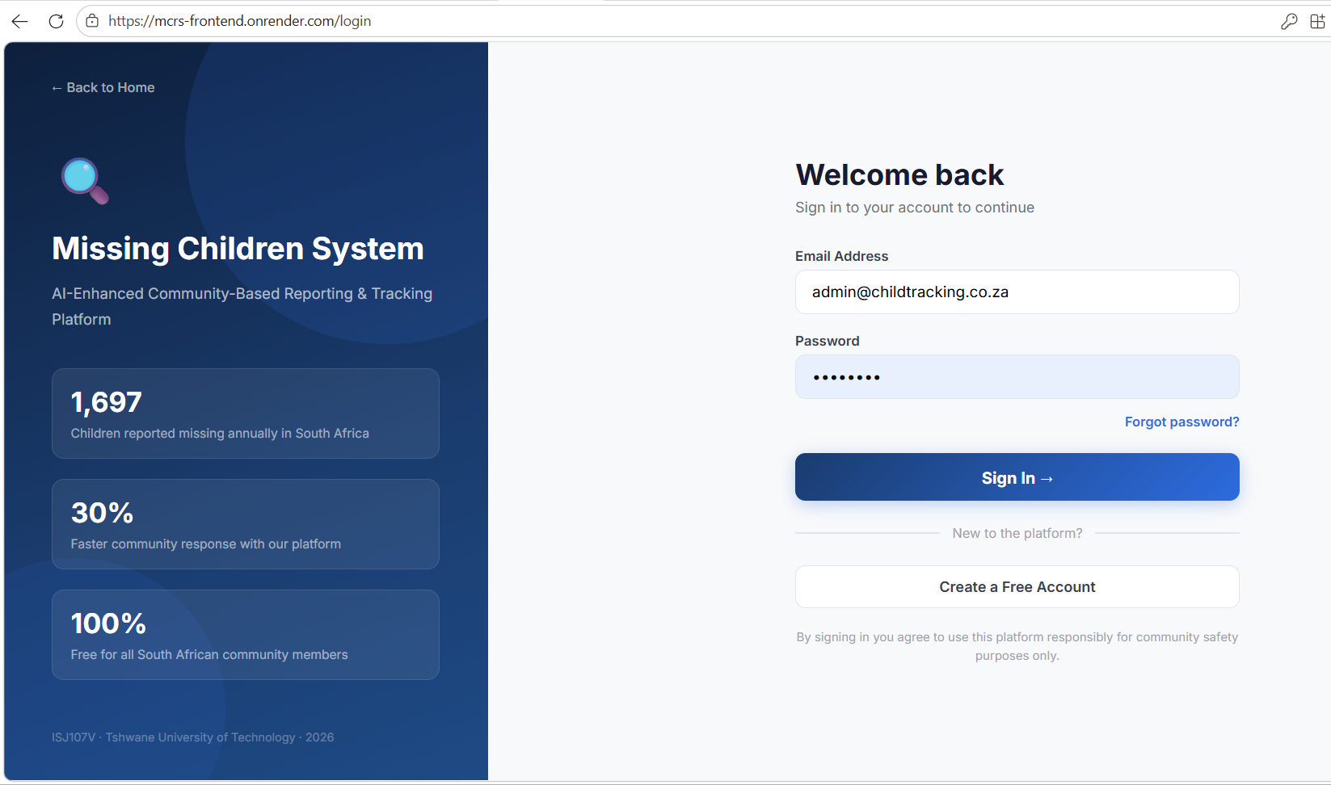
SLIDE 8 · LIVE DEMONSTRATION
Live Demonstration
Dashboard of active reports with photos
Submit a new report, including input validation
Submit a matching report to trigger the AI
Administrator reviews and confirms the AI-flagged duplicate
Mark a child as found, with the safety confirmation
Analytics dashboard
Fallback: the identical system also runs locally on this laptop if the cloud is slow.
Live application: https://mcrs-frontend.onrender.com
Notes:
“I will now switch to the live application.” [Switch to https://mcrs-frontend.onrender.com - this is the 10-minute demo.]

Slide 20
SLIDE 9 · LIMITATIONS AND NEXT STEPS
Three limitations, and how I would fix them
Temporary image storage
Text-only matching
Sleeping free-tier services
Duplicates worded very differently can be missed.
Next: add fuzzy name and location matching, plus lightweight image matching; keep the admin review.
The free hosting tier stores uploaded images temporarily.
Next: move to persistent cloud object storage.
Idle services are slow on the first request.
Next: use a paid always-on instance for the final live environment.
Notes:
“No prototype is perfect. These are my three honest limitations and exactly how I would fix them for the final system.”

Slide 21
SLIDE 10 · THANK YOU
Thank you
I welcome your questions.
Live application: https://mcrs-frontend.onrender.com
Source code: github.com/Ntwani14/child-tracking-ai-platform
Notes:
“Thank you. I am happy to answer technical questions about the design, implementation or testing decisions.”
Be ready to explain: why Spring Boot plus a separate Python service, why JWT and BCrypt, why the threshold changed from 0.75 to 0.25, why alerts go to all users, and why a human reviews duplicates instead of auto-deleting them.

